Slide 1

Project:
Books
Recommendation
System
An example of unsupervised learning model

Slide 2

Book Recommendation System
A Book Recommendation System is a data-driven application designed to suggest books to users based on their preferences, reading history, and behavior.
It employs various data science and machine learning techniques to provide personalized book recommendations, enhancing the reading experience for users.
Our Book Recommendation System provides a list of similar books to the book title provided by the user.

Slide 3

Type of ML Problem
The project focuses on building a book recommendation system.
The problem addressed is the challenge of helping users discover relevant books based on their preferences.
The goal is to enhance the user experience in finding books by providing personalized recommendations.
Book Recommendation System in this case is
treated as
Un-Supervised Machine Learning Problem

Slide 4

Dataset Used for Evaluation
The dataset used for evaluation has following features:
Total no. of instances/books = 11128
There are 4 columns in the dataset comprising of
Book ID, Title, Authors, and Average ratings.
The dataset serves as the foundation for training and evaluating the book recommendation system.

Slide 5
Preprocessing Steps:
Data Collection
Data Cleaning : Data is already clean in our case.
Exploratory Data Analysis (EDA): The project starts by using the Pandas library to read and manipulate the dataset from the CSV file.
Handling Missing Values: The pd.to_numeric function is used to convert the 'average_rating' column to numeric data type, handling any potential errors with errors='coerce’.
Text Feature Creation: A new column 'book_content' is created by combining 'title' and 'authors' for text-based analysis.
Text Vectorization: The TF-IDF Vectorizer from scikit-learn is used to convert the 'book_content' text into a numerical format (TF-IDF matrix).

Slide 6
Preprocessing Steps:
Feature Extraction:
The Sample Data contains Four Attributes
Book ID
Title
Author
Average Rating
Input
Input comprises of Three Attributes
Title
Author
Average Rating

Slide 7
Pre-Processing Steps:
Splitting Data:
Train-Test Split Ratio : 80% -20%
Training Data:
Total Instances = 8902
Test Data:
Total Instances = 2226

Slide 8
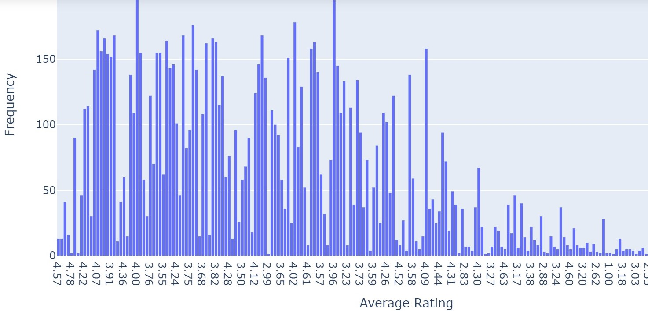
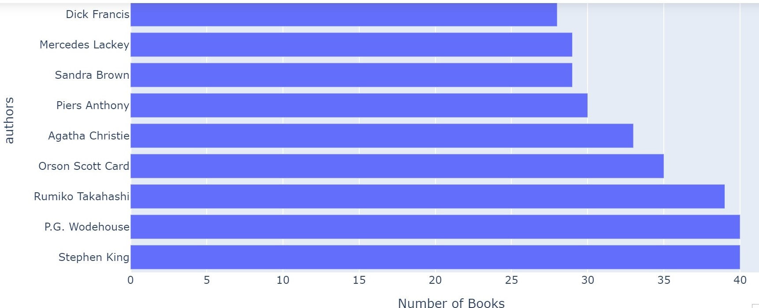
Data Visualization:
Distribution of Average Ratings:
The histogram of average ratings provides an overview of how ratings are distributed across the dataset.
The majority of books seem to have ratings concentrated within a certain range, as indicated by the peaks in the histogram.
Number of Books per Author:
The bar chart depicting the number of books per author gives an idea of the distribution of authors and their contributions to the dataset.
It identifies the top 10 authors with the highest number of books, helping us understand which authors are prolific in terms of book production.

Slide 9
Algorithm Used:
In this model, we used
TF-IDF with Cosine Similarity
TF-IDF and Cosine Similarity:
Cosine similarity is a metric that measures the cosine of the angle between two vectors.
In the TF-IDF representation, each book is represented as a vector, and the cosine similarity between two books is calculated based on the angles between their vectors.
A higher cosine similarity indicates that two books are more similar in terms of their content.

Slide 10
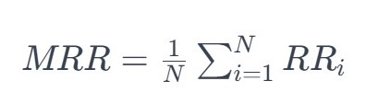
Evaluation Measure:
Mean Reciprocal Rank is used as an evaluation measure in our model.
Mean Reciprocal Rank (MRR) is a metric commonly used in information retrieval and recommendation systems to evaluate the effectiveness of a ranked list of items.
Formula:
N is the total number of recommendation scenarios or queries.
RRi is the Reciprocal Rank for the i-th scenario, indicating how well the system ranked the first relevant book in the list of recommended books for that scenario.
MRR is the average of the Reciprocal Ranks across all scenarios, providing a summary measure of the system's overall performance.

Slide 11
Summary
The dataset includes book information, and the system suggests books based on textual content similarity.
The project involves creating a content-based book recommendation system using TF-IDF with cosine similarity.
Evaluation is performed using Mean Reciprocal Rank, showcasing an approach for personalized book recommendations.
The output consists of a list of similar books according to the user's preference.

Slide 12
Thank you for your attention! -Group Members- Maleeha Asghar Meerab Jalil Momina Farrukh Zainab Jahanzeb Ayesha Tariq

